Slide 1
LAPTOP PRICE PREDICTION Model
(machine learning mini project)

Slide 2
Guide And Group Members
Guide : Asst. Prof. Swati Powar
Group Members:
1.Baseema Kazi (T-21-0215)
2.Sakshi Kanar (T-22-0617)
3. Sanika Kalyankar (T-21-2058)

Slide 3
introduction
Laptop Price Prediction is a challenging task due to the dynamic nature of the market and the many factors that can affect pricing.
The goal of this model is to accurately predict the prices of laptops based on various features.
Laptop Price Prediction is important for both buyers and sellers.
Buyers can use the model to predict the prices of the laptops and make informed purchasing decisions , while sellers can use the model to set appropriate prices for their products.

Slide 4
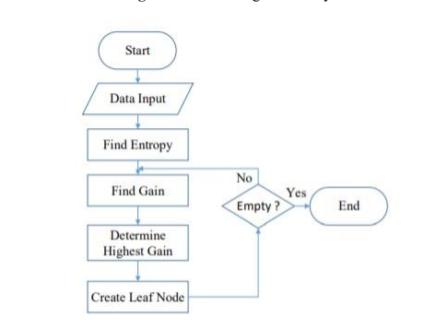
methodology

Slide 5
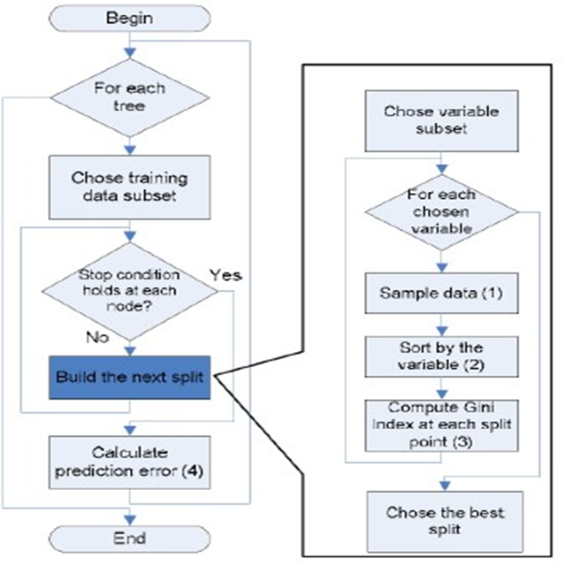
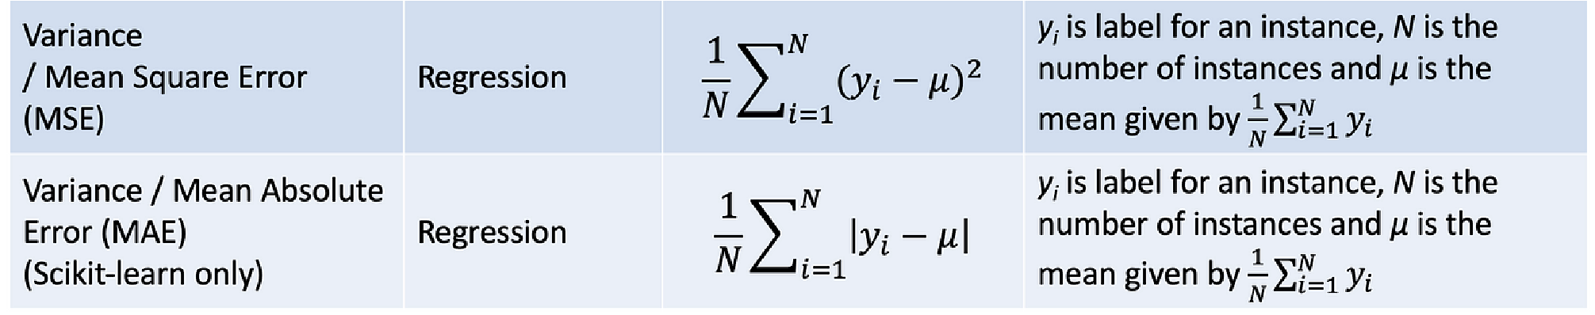
Decision tree
Decision Tree is a Supervised learning technique that is used here for Regression problems.
It is a tree-structured classifier, where internal nodes represent the features of a dataset, branches represent the decision rules and each leaf node represents the outcome.

Slide 6
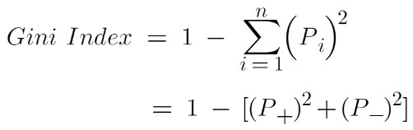
Random forest
Random Forest creating a number of Decision Trees during the training phase.
Each tree is constructed using a random subset of the data set to measure a random subset of features in each partition.
This randomness introduces variability among individual trees, reducing the risk of overfitting and improving overall prediction performance. In prediction, the algorithm aggregates the results of all trees, averaging (for regression tasks) .

Slide 7
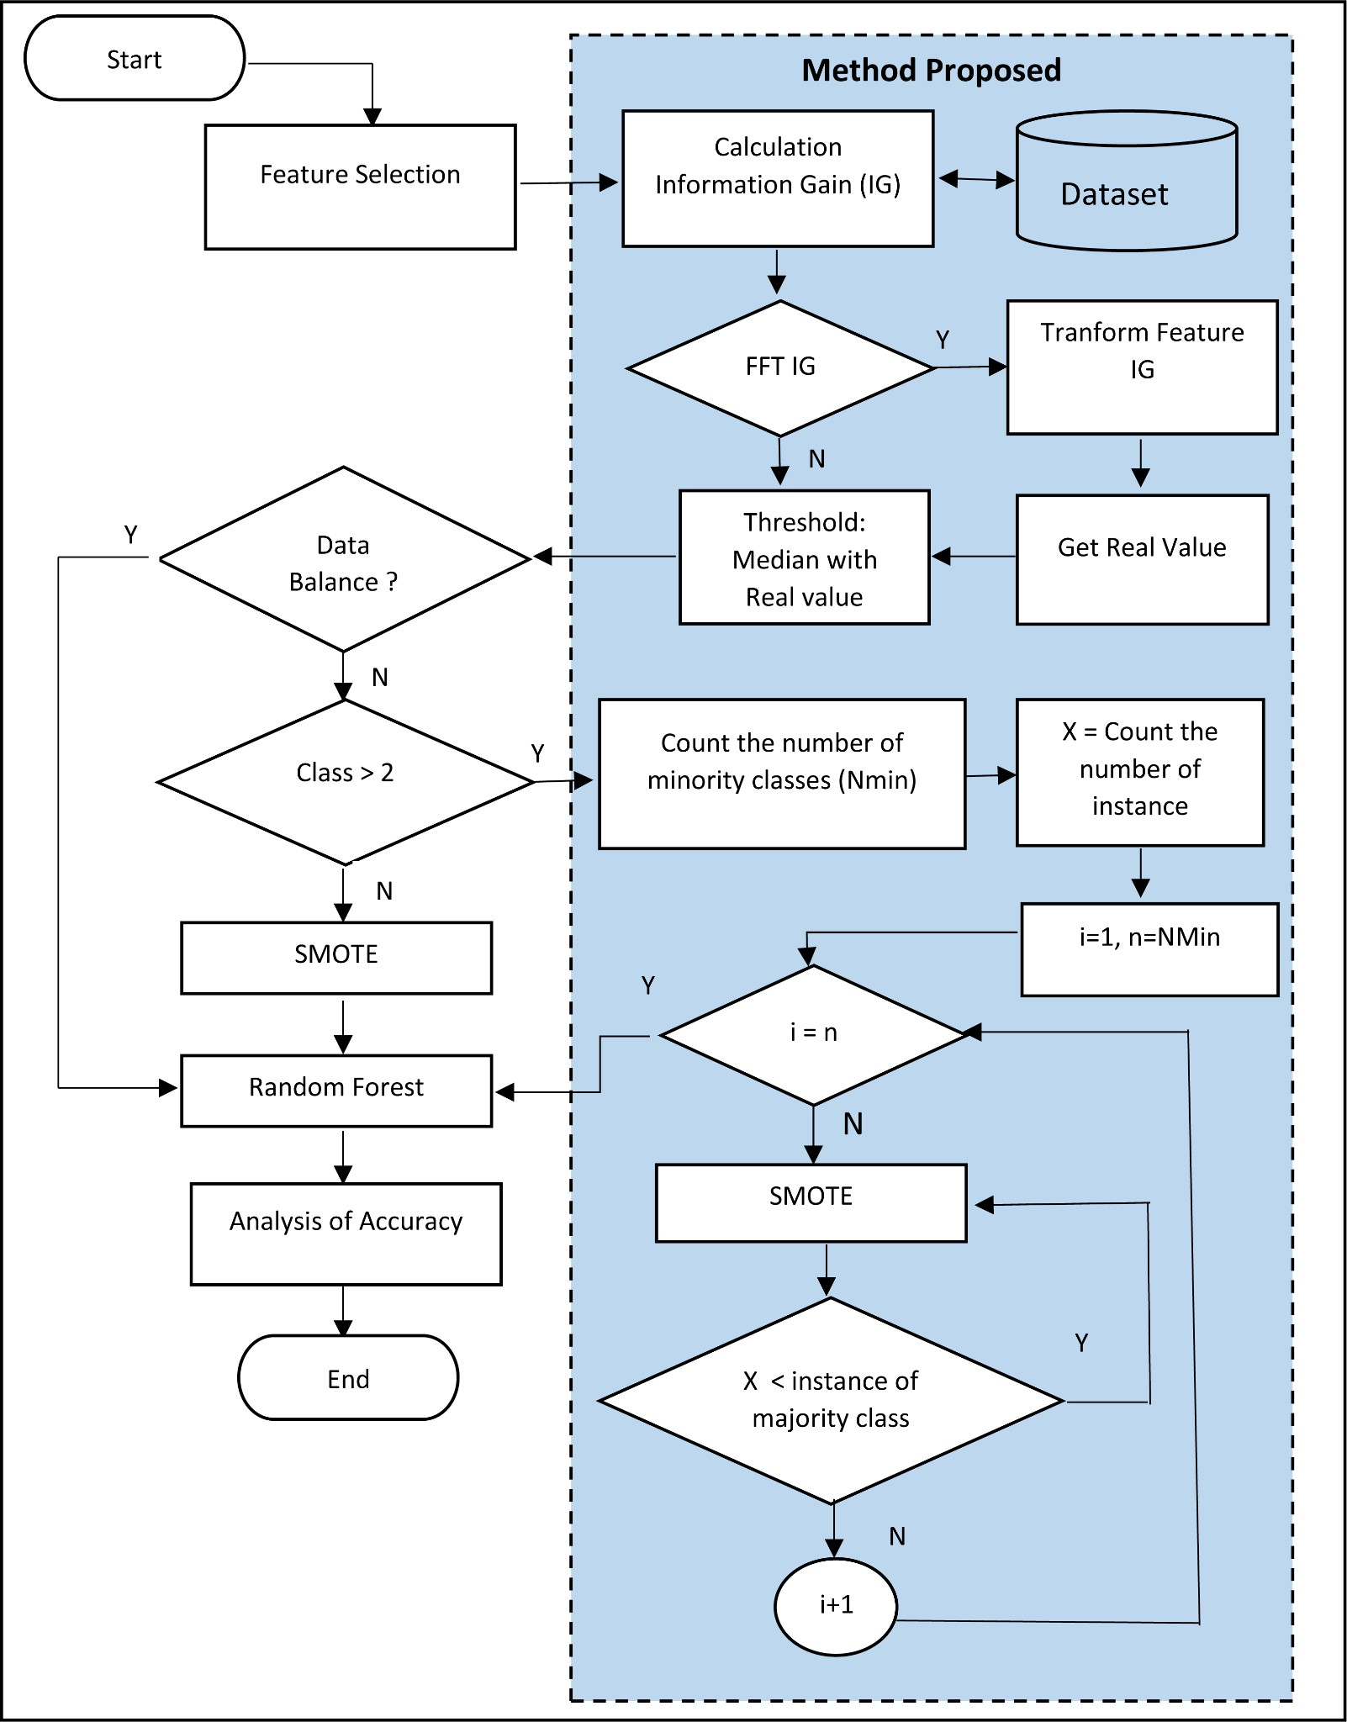

Slide 8
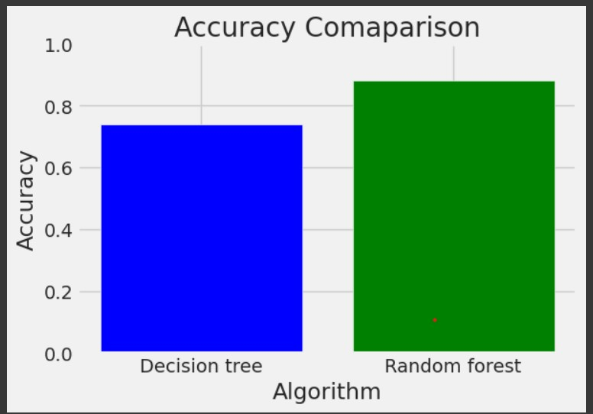
COMPARATIVE ANALYSIS OF ALGORITHMS
In predicting laptop prices, the Random Forest often yields higher accuracy compared to the Decision Tree .
This is because Random Forest is an ensemble learning method that combines multiple decision trees, thereby reducing overfitting and increasing robustness in predictions.
The aggregation of multiple trees' outputs in Random Forest tends to provide more reliable and accurate results, particularly in complex datasets like those often encountered in pricing predictions.

Slide 9
conclusion
In summary, research into laptop price prediction using machine learning techniques highlights the significance of feature engineering and selection for model performance. Despite varying methodologies and datasets, there's consensus on machine learning's potential to aid consumers and retailers in informed decision-making. As machine learning advances, further research promises to refine prediction models for the dynamic laptop market.

Slide 10
Thank you

